Slide 1

Understanding Supervised Learning and Linear Regression
Supervised learning is a machine learning technique where a model is trained on a labeled dataset to make predictions. Linear regression is a specific supervised learning algorithm used to model relationships between variables.
rH
by raqeeb Hashmi

Slide 2


Supervised Learning and Linear Regression in Education
Supervised Learning
Supervised learning is a type of machine learning where the algorithm learns from labeled data. In educational settings, this can be used to predict student outcomes and identify areas for improvement.
Linear Regression
Linear regression is a type of supervised learning algorithm used to model the relationship between two variables. For example, it can be used to predict a student's score based on the number of hours they study.
Improved Student Outcomes: By using supervised learning and linear regression, educators can identify students who may be struggling and provide targeted interventions to improve their performance.
Streamlined Administrative Tasks: Predictive models can be used to automate administrative tasks, such as scheduling and resource allocation, freeing up educators to focus on teaching and student support.

Slide 3


Types of Supervised Learning
Regression
Regression is a type of supervised learning used to predict continuous values. It involves finding the relationship between a dependent variable and one or more independent variables.
Classification
Classification is another type of supervised learning used to predict discrete values. It involves finding the relationship between a dependent variable and one or more independent variables, and then classifying the data into different categories.

Slide 4
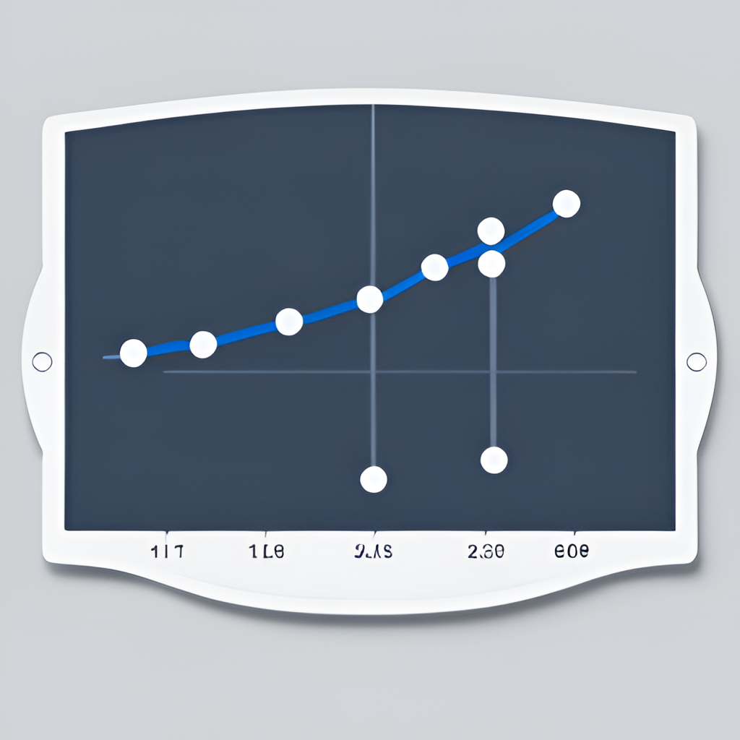
Linear Regression: Definition and Use Cases
Linear regression is a type of supervised learning algorithm used in machine learning and statistics. It is used to model the relationship between two variables where one variable is dependent on the other variable. The goal of linear regression is to find the best fit line that describes the relationship between the variables. This line can then be used to make predictions about the dependent variable based on the independent variable.
Example: Predicting Student Scores Based on Study Hours
Let's take an example of predicting the score of a student based on the number of hours they study. We have a dataset that contains the number of hours a student studies and their corresponding scores. We can use linear regression to find the best fit line that describes the relationship between the number of hours studied and the score obtained. Once we have this line, we can use it to make predictions about the score of a student based on the number of hours they study.

Slide 5
What is Linear Regression?
1
Equation
3
Evaluating the Model
After training our model, we need to evaluate its performance. We can do this by using a test dataset that the model has not seen before. We can then compare the predictions made by our model with the actual scores and calculate the error. The lower the error, the better the performance of our model.
The equation for linear regression is: y = mx + c, where y is the dependent variable, x is the independent variable, m is the slope, and c is the y-intercept.
2
Training the Model
Once we have understood our dataset, we can start training our model. In linear regression, we want to find the best fit line that describes the relationship between the number of hours studied and the score obtained. We use a cost function to measure how well our line fits the data and adjust the parameters of the line until we get the best fit. Once we have the best fit line, we can use it to make predictions about the score of a student based on the number of hours they study.

Slide 6
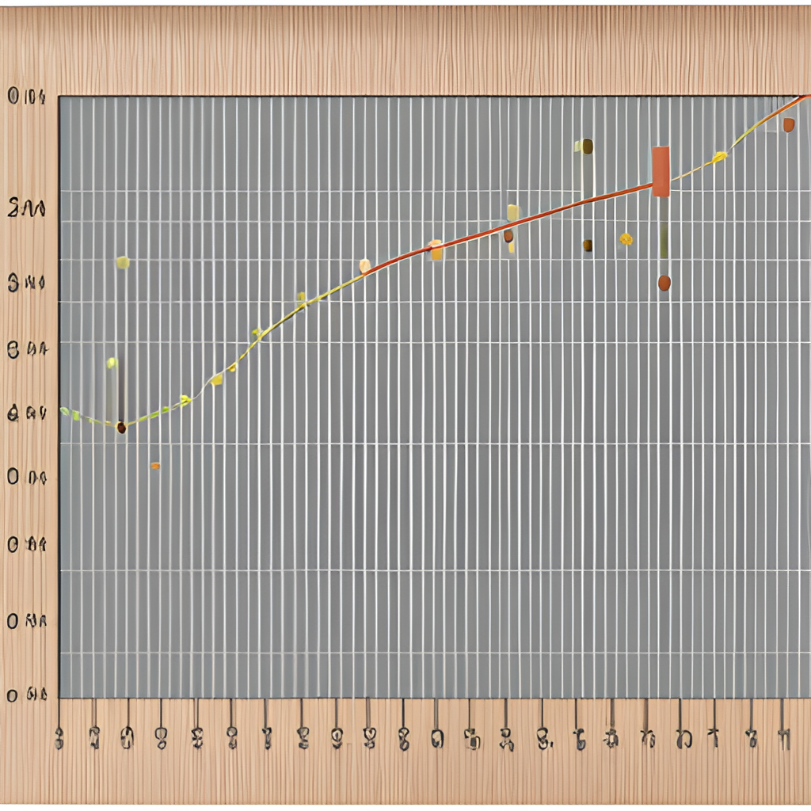
Example: Predicting Student Scores Based on Hours Studied
1
Data Collection
We collect data on the number of hours students study and their corresponding scores in a particular subject.
2
Data Preparation
We clean and preprocess the data, handling missing values and outliers.
3
Model Training
We train a linear regression model using
the prepared data.

Slide 7

Model Training and Evaluation
1
Splitting the Data
2
Training the Model
We divide the dataset into training and testing sets to evaluate the model's performance.
We fit the linear regression model to the training data.
3
Evaluating the Model
We assess the performance of the model using evaluation metrics like mean squared error or R-squared.

Slide 8
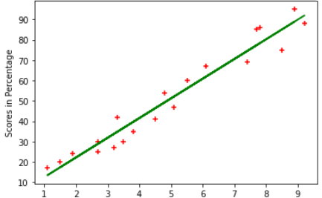
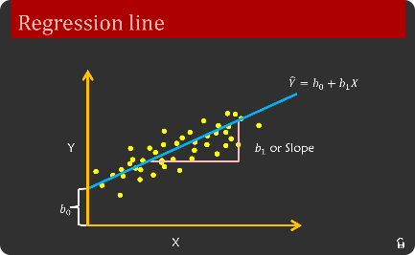
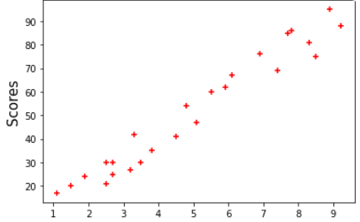
Visualizing Results with Images and Charts
Scatter Plot
Regression Line
Residual Plot
We create a scatter plot to visualize the relationship between hours studied and student scores.
We plot a line that represents the best fit of our linear regression model to the data points.
We analyze the residuals to check for any patterns, indicating deviations from the linear regression assumptions.

Slide 9
Conclusion and Future Applications
Linear Regression: A Powerful Tool for Predictive Analysis
In this presentation, we explored the concept of supervised learning and how it can be used to make predictions based on data. One of the most popular and widely-used techniques for supervised learning is linear regression. We demonstrated how linear regression can be used to predict the score of a student based on the number of hours they study.
Linear regression is a powerful tool for predictive analysis, and it has a wide range of applications in various fields such as finance, healthcare, and marketing. With the help of linear regression, we can make accurate predictions about future trends and outcomes, which can be incredibly valuable for businesses and organizations.
Future Applications of Supervised Learning
Supervised learning is a rapidly evolving field, and there are many exciting applications on the horizon. One area where supervised learning is likely to have a significant impact is in healthcare. By analyzing patient data, we can predict the likelihood of certain diseases and conditions, which can help doctors to provide more personalized and effective treatment.
Another area where supervised learning is likely to be used extensively is in finance. By analyzing market data, we can make accurate predictions about future trends and outcomes, which can help investors to make informed decisions about their investments.

